Slide 1


Slide 2
Patrick Hall, Navdeep Gill, Mark Chan

Slide 3
Machine Learning Interpretability (MLI)

Slide 4



MEET
THE MAKERS
PATRICK HALL
NAVDEEP GILL
MARK CHAN
Patrick Hall is a senior director for data science products at H2O.ai and adjunct faculty in the Department of Decision Sciences at George Washington University. He is the lead author of a popular white paper on techniques for interpreting machine learning models and a frequent speaker on the topics of FAT/ML and explainable artificial intelligence (XAI) at conferences and on webinars.
Navdeep Gill is a software engineer and data scientist at H2O.ai. He has made important contributions to the popular open source h2o machine learning library and the newer open source h2o4gpu library. Navdeep also led a recent Silicon Valley Big Data Science Meetup about interpretable machine learning.
Mark Chan is a software engineer and customer data scientist at H2O.ai. He has contributed to the open source h2o library and to critical financial services customer products.

Slide 5
First-time Qwiklab Account Setup
Go to http://h2oai.qwiklab.com
Click on “JOIN” (top right)
Create a new account with a valid email address
You will receive a confirmation email
Click on the link in the confirmation email
Go back to http://h2oai.qwiklab.com and log in
Go to the Catalog on the left bar
Choose “Introduction to Driverless AI”
Wait for instructions

Slide 6
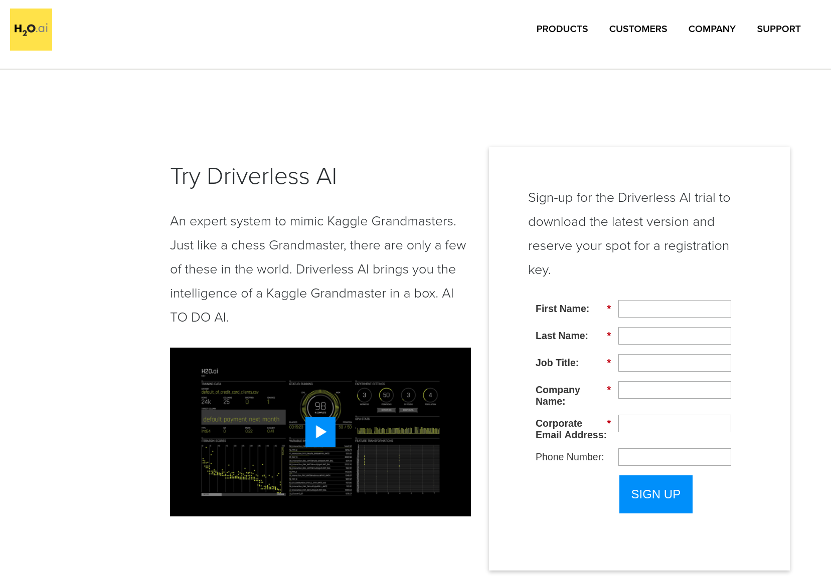

DriverlessAI Demo Key
Sign Up for a demo key https://www.h2o.ai/try-driverless-ai/

Slide 7

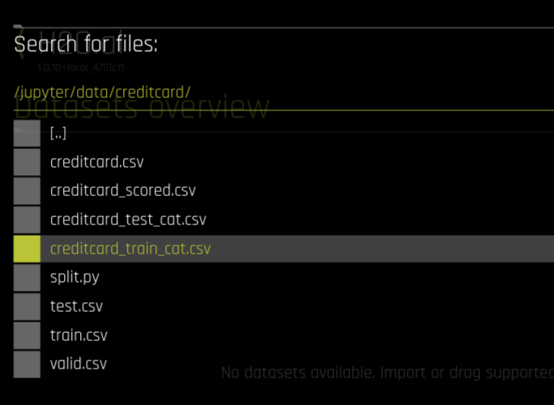
Dataset for Hands On Lab
/jupyter/data/creditcard/creditcard_train_cat.csv

Slide 8
Big Ideas

Slide 9
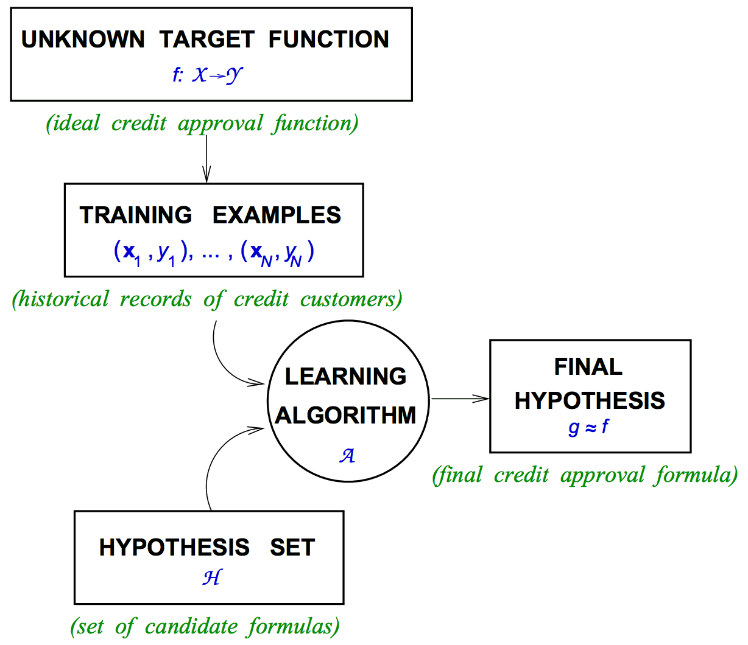
Learning from data …
Adapted from:
Learning from Data. https://work.caltech.edu/textbook.html

Slide 10
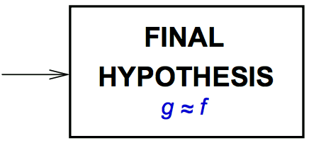
Learning from data …
transparently.
(explain predictions with reason codes)
EXPLAIN
HYPOTHESIS
h ≈ g, β_{j} g(x^{(i)}_{j}), g(x^{(i)}_{(-j)})
Adapted from:
Learning from Data. https://work.caltech.edu/textbook.html

Slide 11

Increasing fairness, accountability, and trust by
decreasing unwanted sociological biases
Source: http://money.cnn.com/, Apple Computers

Slide 12




A framework for interpretability
Complexity of learned functions:
Linear, monotonic
Nonlinear, monotonic
Nonlinear, non-monotonic
(~ Number of parameters/VC dimension)
Scope of interpretability:
Global vs. local
Enhancing trust and understanding: the mechanisms and results of an interpretable model should be both transparent AND dependable.
Understanding ~ transparency
Trust ~ fairness and accountability
Application domain:
Model-agnostic vs. model-specific
Notes:
Wherever possible, “interpretability” of each technique in this article is deconstructed into more basic components - complexity, scope, understanding, and trust - which I will first outline below.
Complexity of response function to be explained
Linear, monotonic functions: Functions created by linear regression algorithms are probably the most interpretable class of models. These models will be referred to here as linear and monotonic, meaning that for a change in any given independent variable (or sometimes combination or function of an independent variable) the response function changes at a defined rate, in only one direction, and at a magnitude represented by a readily available coefficient. Monotonicity also enables intuitive and even automatic reasoning about predictions. For instance, if a lender rejects your credit card application, they can tell you why because their probability-of-default model often assumes your credit score, your account balances, and the length of your credit history are monotonically related to your ability to pay your credit card bill. When these explanations are created automatically, they are typically called reason codes. Of course, linear and monotonic response functions enable the calculation of relative variable importance measures too. Linear and monotonic functions have several uses in machine learning interpretability. Part 2 and sections in Part 3 -- surrogate models and Local Interpretable Model-agnostic Explanations -- below all discuss the many ways linear, monotonic functions can be used to make machine learning interpretable.
Nonlinear, monotonic functions: Although most machine learned response functions are nonlinear, some can be constrained to be monotonic with respect to any given independent variable. While there is no single coefficient that represents the change in the response function induced by a change in a single independent variable, nonlinear and monotonic functions do always change in one direction as a single input variable changes. Nonlinear, monotonic response functions usually allow for the generation of both reason codes and relative variable importance measures. Nonlinear, monotonic response functions are highly interpretable and often suitable for use in regulated applications.
(Of course there are linear, non-monotonic machine-learned response functions that can, for instance, be created by the multi-variate adaptive regression splines approach. These functions are not highlighted here because they tend to be less accurate predictors than purely nonlinear, non-monotonic functions while also lacking the high interpretability of their monotonic counterparts.)
Nonlinear, non-monotonic functions: Most machine learning algorithms create nonlinear, non-monotonic response functions. This class of functions are the most difficult to interpret. They can change in a positive and negative direction and at a varying rate for any change in an independent variable. Typically, the only standard interpretability measure these functions provide are relative variable importance measures. You may need to use a combination of additional techniques presented below to interpret these extremely complex models.
Scope of interpretability
Global interpretability: Some of the presented techniques facilitate global interpretations of machine learning algorithms, their results, or the machine-learned relationship between the inputs and the dependent variable(s) (e.g. the model of the conditional distribution). Global interpretations help us understand the entire conditional distribution modeled by the trained response function, but global interpretations can be approximate or based on average values.
Local interpretability: Local interpretations promote understanding of small regions of the conditional distribution, such as clusters of input records and their corresponding predictions, or deciles of predictions and their corresponding input rows. Because small sections of the conditional distribution are more likely to be linear, monotonic, or otherwise well-behaved, local explanations can be more accurate than global explanations.
Understanding and trust
Machine learning algorithms and the functions they create during training are sophisticated, intricate, and opaque. Humans who would like to use these models have basic, emotional needs to understand and trust them because we rely on them for our livelihoods or because we need them to make important decisions for us. For some users, technical descriptions of algorithms in text books and journals provide enough insight to fully understand machine learning models. For these users, cross-validation, error measures, and assessment plots probably also provide enough information to trust a model. Unfortunately, for many applied practitioners the usual definitions and assessments don’t often inspire full trust and understanding in machine learning models and their results. The techniques presented here go beyond the standard practices to engender greater understanding and trust. These techniques enhance understanding by providing specific insights into the mechanisms of the algorithms and the functions they create, or by providing detailed information about the answers they provide. The techniques below enhance trust by enabling users to observe or ensure the stability and dependability of machine learning algorithms, the functions they create, or the answers they generate.
Another important way to classify model interpretability techniques is whether they are model-agnostic, meaning they can be applied to different types of machine learning algorithms, or model-specific, meaning techniques that are only applicable for a single type or class of algorithm. The techniques herein are described in an approachable, high-level manner that is generally model-agnostic. Model-specific techniques will be called out for the reader when appropriate.
The techniques are presented in three parts. Part 1 includes approaches for seeing and understanding your data in the context of training and interpreting machine learning algorithms, part 2 introduces techniques for combining linear models and machine learning algorithms for situations where interpretability is of paramount importance, and part 3 describes approaches for understanding and validating the most complex types of predictive models.

Slide 13
Big Challenges

Slide 14


Linear Models
Strong model locality
Usually stable models and explanations
Machine Learning
Weak model locality
Sometimes unstable models and explanations
(a.k.a. The Multiplicity of Good Models )

Slide 15


Linear Models
Wasted marketing.
Exact explanations for approximate models.
Number of Purchases
Lost profits.
“For a one unit increase in age, the number of purchases increases by 0.8 on average.”
Age
“Slope begins to decrease here. Act to optimize savings.”
Machine Learning
Number of Purchase
“Slope begins to increase here sharply. Act to optimize profits.”
Approximate explanations for exact models.
Age

Slide 16
A Few of Our Favorite Things

Slide 17
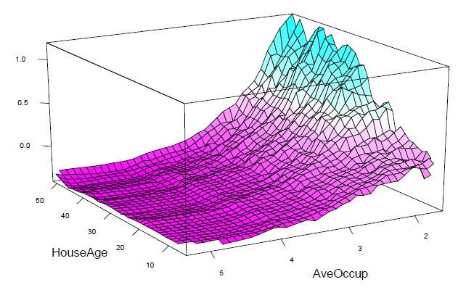
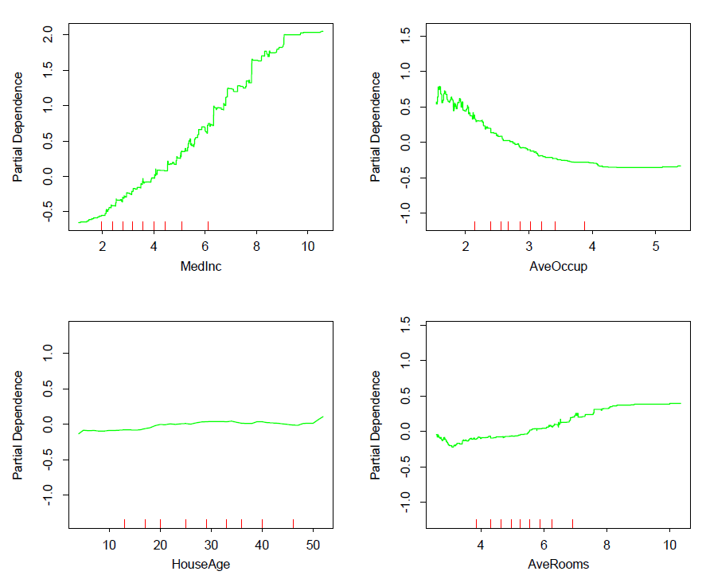
Partial dependence plots
HomeValue ~ MedInc + AveOccup + HouseAge + AveRooms
Source: http://statweb.stanford.edu/~tibs/ElemStatLearn/printings/ESLII_print10.pdf
Notes:
Figure 5: One- and two-dimensional partial dependence plots from a gradient boosted tree ensemble model of the well-known California housing data set. Image: http://statweb.stanford.edu/~tibs/ElemStatLearn/printings/ESLII_print10.pdf
Partial dependence plots show us the way machine-learned response functions change based on the values of one or two independent variables of interest while averaging out the effects of all other independent variables. Partial dependence plots with two independent variables are particularly useful for visualizing complex types of variable interactions between the independent variables of interest. Partial dependence plots can be used to verify monotonicity of response functions under monotonicity constraints, and they can be used to see the nonlinearity, non-monotonicity, and two-way interactions in very complex models. In fact, the way partial dependence plots enhance understanding is exactly by showing the nonlinearity, non-monotonicity, and two-way interactions in between independent variables and a dependent variable in complex models. They can also enhance trust when displayed relationships conform to domain knowledge expectations, when the plots remain stable or change in expected ways over time, or when displayed relationships remain stable under minor perturbations of the input data.
Partial dependence plots are global in terms of the rows of a data set, but local in terms of the independent variables. They are used almost exclusively to show the relationship between one or two independent variables and the dependent variable over the domain of the independent variable(s). Individual conditional expectation (ICE) plots, a newer and less well-known adaptation of partial dependence plots, can be used to create more localized explanations using the same ideas as partial dependence plots. ICE plots are particularly useful when there are strong relationships between many independent variables.

Slide 18
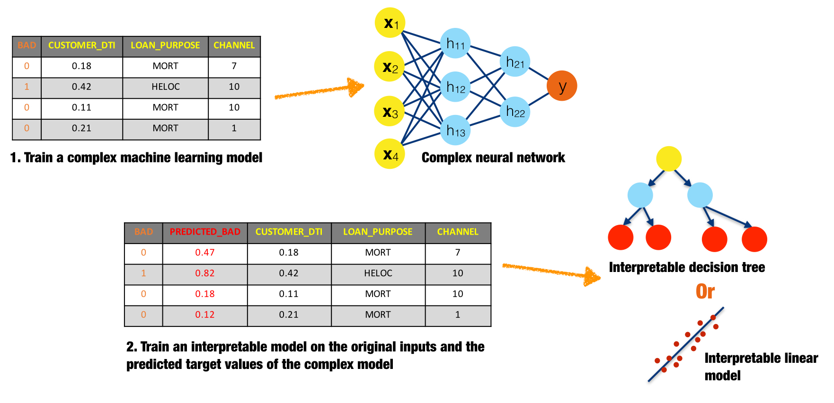
Surrogate models
Notes:
Figure 14: An illustration of surrogate models for explaining a complex neural network. Figure courtesy of Patrick Hall and the h2o.ai team.
A surrogate model is a simple model that is used to explain a complex model. Surrogate models are usually created by training a linear regression or decision tree on the original inputs and predictions of a complex model. Coefficients, variable importance, trends, and interactions displayed in the surrogate model are then assumed to be indicative of the internal mechanisms of the complex model. There are few, possibly no, theoretical guarantees that the simple surrogate model is highly representative of the more complex model.
What is the scope of interpretability for surrogate models?
Generally surrogate models are global. The globally interpretable attributes of a simple model are used to explain global attributes of a more complex model. However there is nothing to preclude fitting surrogate models to more local regions of a complex model's conditional distribution, such as clusters of input records and their corresponding predictions, or deciles of predictions and their corresponding input rows. Because small sections of the conditional distribution are more likely to be linear, monotonic, or otherwise well-behaved, local surrogate models can be more accurate than global surrogate models. Local Interpretable Model-agnostic Explanations (discussed in the next section) is a formalized approach for local surrogate models. Of course, global and local surrogate models can be used together to foster both global and local interpretability.
What complexity of functions can surrogate models help explain?
Surrogate models can help explain machine learning models of any complexity, but they are probably most helpful for nonlinear, non-monotonic models.
How do surrogate models enhance understanding?
Surrogate models enhance understanding because they provide insight into the internal mechanisms of complex models.
How do surrogate models enhance trust?
Surrogate models enhance trust when their coefficients, variable importance, trends, and interactions are in line with human domain knowledge and reasonable expectations of modeled phenomena. Surrogate models can increase trust when used in conjunction with sensitivity analysis to test that explanations remain stable and in line with human domain knowledge and reasonable expectations when data is lightly and purposefully perturbed, when interesting scenarios are simulated, or as data changes over time.

Slide 19
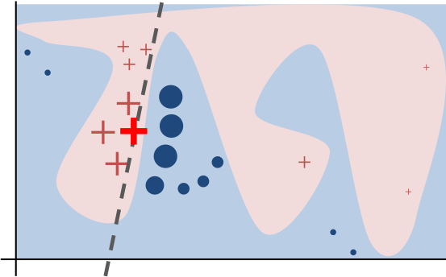
Local interpretable model-agnostic explanations (LIME)
Linear model used to explain nonlinear decision boundary in local region.
Weighted explanatory samples.
Source: https://github.com/marcotcr/lime
Notes:
Figure 15: An illustration of the LIME process in which a weighted linear model is used to explain a single prediction from a complex neural network. Image courtesy of Marco Tulio Ribeiro. Image: https://www.oreilly.com/learning/introduction-to-local-interpretable-model-agnostic-explanations-lime
LIME is a prescribed method for building local surrogate models around single observations. It is meant to shed light on how decisions are made for specific observations. LIME requires that a set of explainable records be found, simulated, or created. This set of well-understood records is used to explain how machine learning algorithms make decisions for other, less well-understood records. An implementation of LIME may proceed as follows. First the set of explainable records are scored using the complex model. Then to interpret a decision about another record, the explanatory records are weighted by their closeness to that record, and an L1 regularized linear model is trained on this weighted explanatory set. The parameters of the linear model then help explain the prediction for the selected record.
LIME was originally described in the context of explaining image or text classification decisions. It could certainly also be applied to business or customer data, for instance by explaining customers at every decile of predicted probabilities for default or churn, or by explaining representative customers from well-known market segments.
What is the scope of interpretability for LIME?
LIME is a technique for local interpretability.
What complexity of functions can LIME help explain?
LIME can help explain machine learning models of any complexity, but it is probably most appropriate for nonlinear, non-monotonic models.
How does LIME enhance understanding?
LIME provides insight into the important variables and their linear trends around specific, important observations, even for extremely complex response functions.
How does LIME enhance trust?
LIME increases trust when the important variables and their linear trends around specific records conform to human domain knowledge and reasonable expectations of modeled phenomena. LIME can also enhance trust when used in conjunction with maximum activation analysis to see that a model treats obviously different records using different internal mechanisms and obviously similar records using similar internal mechanisms. LIME can even be used as a type of sensitivity analysis to determine whether explanations remain stable and in line with human domain knowledge and expectations when data is intentionally and subtly perturbed, when pertinent scenarios are simulated, or as data changes over time.

Slide 20
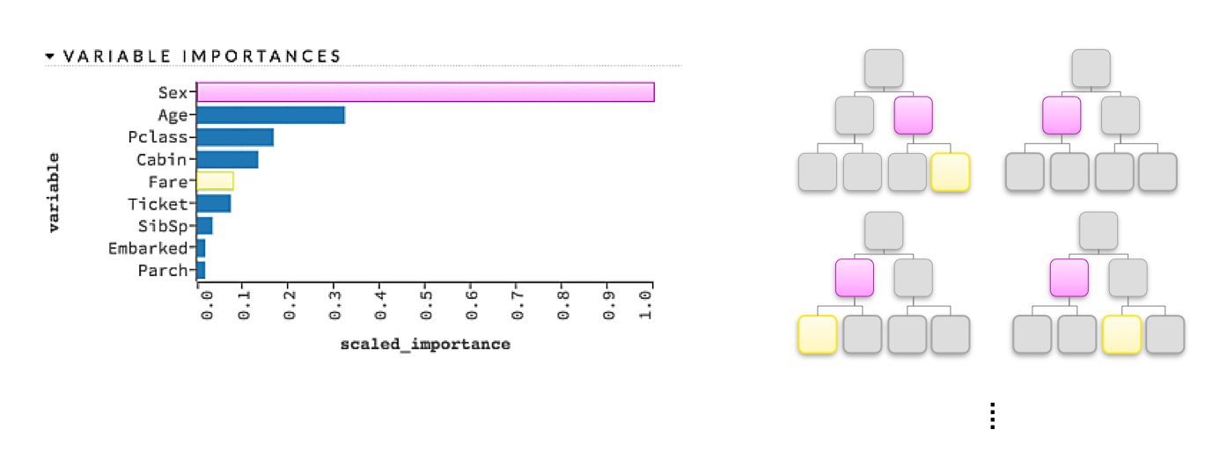
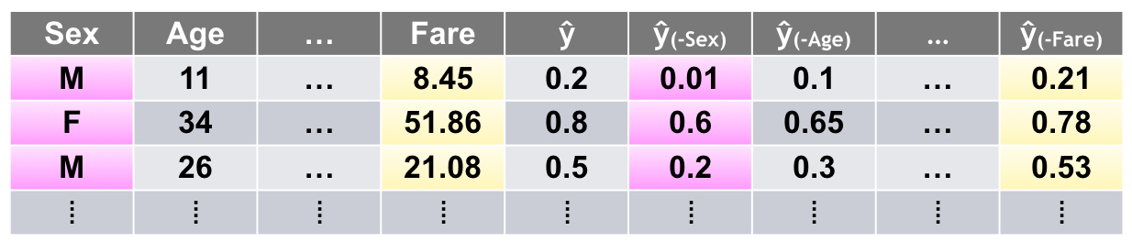
Variable importance measures
Global variable importance indicates the impact of a variable on the model for the entire training data set.
Local variable importance can indicate the impact of a variable for each decision a model makes – similar to reason codes.
Notes:
Figure 18: An illustration of variable importance in a decision tree ensemble model. Figure courtesy of Patrick Hall and the h2o.ai team.
Variable importance measures are typically seen in tree-based models, but are sometimes also reported for other models. As illustrated in figure 18, a simple heuristic rule for variable importance in a decision tree is related to the depth and frequency at which a variable is split on in a tree, where variables used higher in the tree and more frequently in the tree are more important. For a single decision tree, a variable's importance is quantitatively determined by the cumulative change in the splitting criterion for every node in which that variable was chosen as the best splitting candidate. For a gradient boosted tree ensemble, variable importance is calculated as it is for a single tree but aggregated for the ensemble. For a random forest, variable importance is also calculated as it is for a single tree and aggregated, but an additional measure of variable importance is provided by the change in out-of-bag accuracy caused by shuffling the independent variable of interest, where larger decreases in accuracy are taken as larger indications of importance. (Shuffling is seen as zeroing-out the effect of the given independent variable in the model, because other variables are not shuffled.) For neural networks, variable importance measures are typically associated with the aggregated, absolute magnitude of model parameters for a given variable of interest. Global variable importance techniques are typically model-specific, and practitioners should be aware that unsophisticated measures of variable importance can be biased toward larger scale variables or variables with a high number of categories.
Leave-One-Covariate-Out (LOCO)
Figure 19: An illustration of the LOCO approach. Figure courtesy of Patrick Hall and the h2o.ai team.
A recent preprint article put forward a local, model-agnostic generalization of mean accuracy decrease variable importance measures called Leave-One-Covariate-Out, or LOCO. LOCO was originally described in the context of regression models, but the general idea of LOCO is model-agnostic and can be implemented in various ways. A general implementation of LOCO may proceed as follows. LOCO creates local interpretations for each row in a training or unlabeled score set by scoring the row of data once and then again for each input variable (e.g., covariate) in the row. In each additional scoring run, one input variable is set to missing, zero, its mean value, or another appropriate value for leaving it out of the prediction. The input variable with the largest absolute impact on the prediction for that row is taken to be the most important variable for that row's prediction. Variables can also be ranked by their impact on the prediction on a per-row basis. LOCO also creates global variable importance measures by estimating the mean change in accuracy for each variable over an entire data set and can even provide confidence intervals for these global estimates of variable importance.
What is the scope of interpretability for variable importance measures?
Variable importance measures are usually global in scope; however, the LOCO approach offers local variable importance measures for each row in a training set or in new data.
What complexity of functions can variable importance measures help explain?
Variable importance measures are most useful for nonlinear, non-monotonic response functions but can be applied to many types of machine-learned response functions.
How do variable importance measures enhance understanding?
Variable importance measures increase understanding because they tell us the most influential variables in a model and their relative rank.
How do variable importance measures enhance trust?
Variable importance measures increase trust if they are in line with human domain knowledge and reasonable expectations. They also increase trust if they remain stable when data is lightly and intentionally perturbed and if they change in acceptable ways as data changes over time or when pertinent scenarios are simulated.

Slide 21
Current product roadmap
(Roadmap subject to change without notice.)
Time Frame | Features
Near-Term | Reason Codes in MOJO (i.e. Prod), Sensitivity Analysis, Multinomial Explanations
Medium-Term | Table Plots, Residual Analysis, Python API, Performance Refactor (GPU), Report Export
Long-Term | R API, AutoMLI

Slide 22
Resources

Slide 23

Machine Learning Interpretability with
H2O Driverless AI
http://docs.h2o.ai/driverless-ai/latest-stable/docs/booklets/MLIBooklet.pdf
Ideas on Interpreting Machine Learning
https://www.oreilly.com/ideas/ideas-on-interpreting-machine-learning
FAT/ML
http://www.fatml.org/
MLI Resources
https://github.com/h2oai/mli-resources

Slide 24
MLI Demo

Slide 25
Questions?

